Slide 1
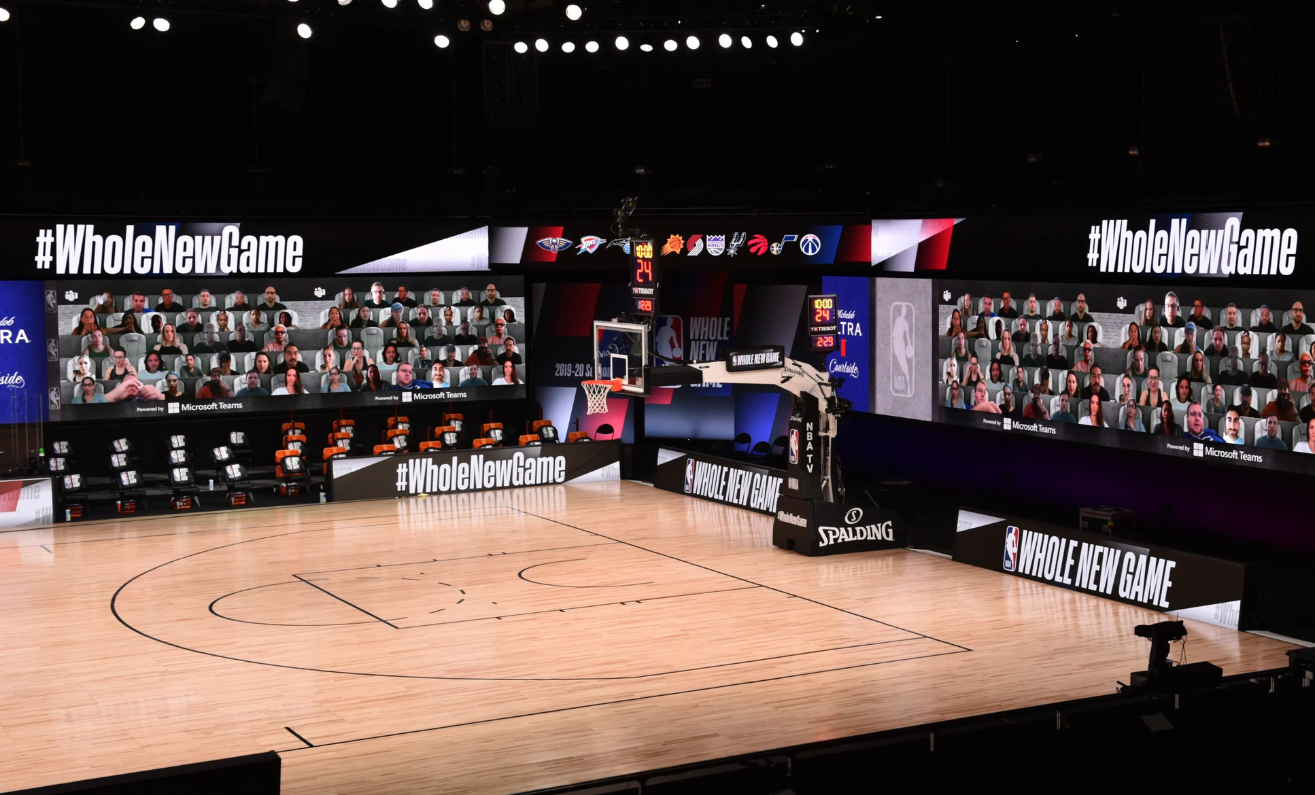
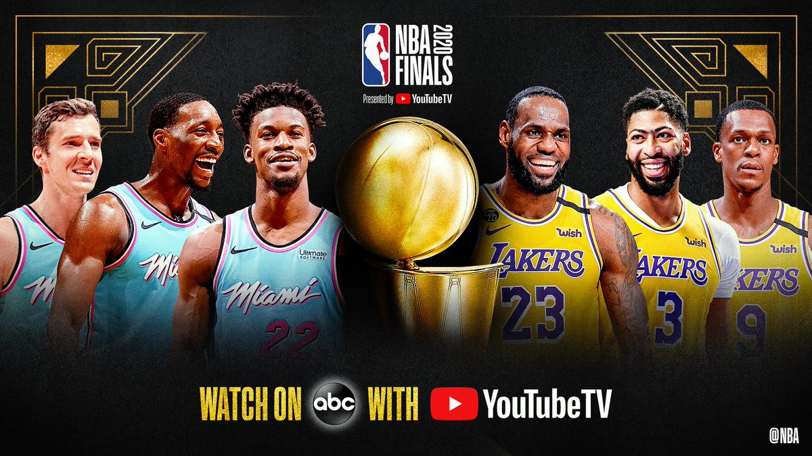

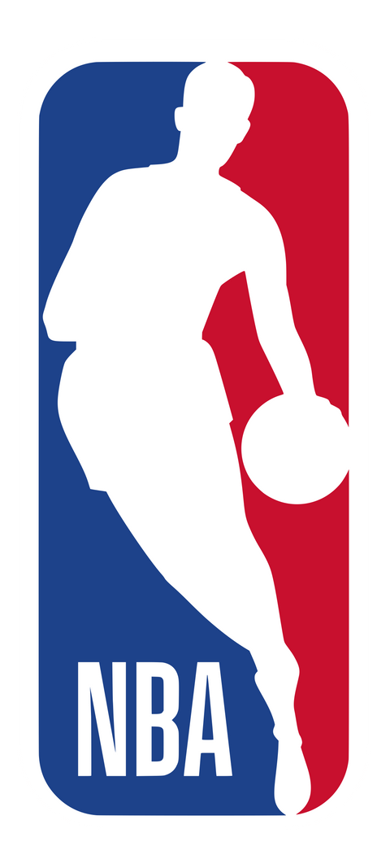
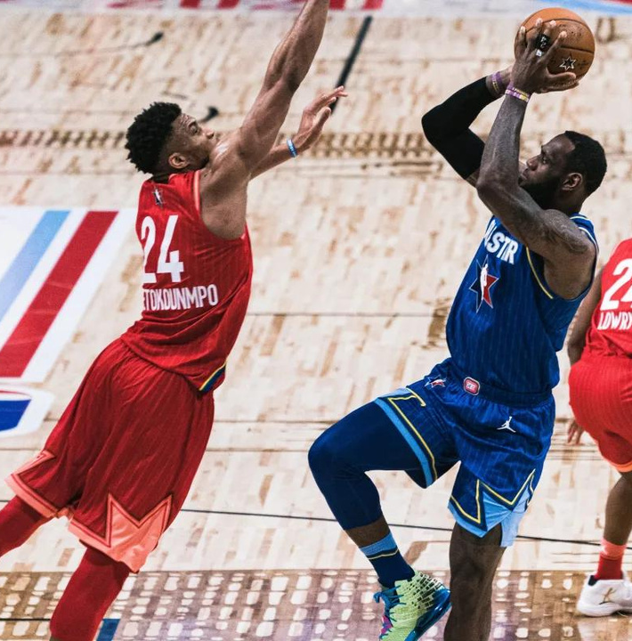
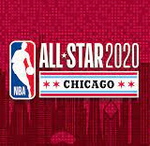
Fan Engagement
Text Analytics
Presented By: Alliyah Thompson
Notes:
Hello Everyone,
My name is Alliyah Thompson and today I will be presenting
my analysis of the Fan Engagement Case of the NBA, based upon the data collection of tweets from Oct 2019 - Oct 2020.

Slide 2
Presentation Outline
Understanding the Data
Data Selection
Data Cleaning
Insights
Summary
Recommendations
Notes:
In today's presentation, I will review the following sections beginning with the data process steps which are vital in explaining the end results.
1. Understanding the Data:
The first step will begin with investigating the data's columns and rows. Additional research also helps with understanding the importance of each month and when significant fan moments occur.
2. Data Selection:
Determining how the data will be evaluated for further analysis.
3. Data Cleaning:
Cleaning the tweets to remove uppercase, punctuation, numbers, and whitespace.
4. Insights :
The tweets can be analyzed by frequent words, emerging topics, popular athletes by the team.
5. Summary & Recommendations:
After providing a detailed analysis of my findings, I will provide a summary followed by recommendations.

Slide 3
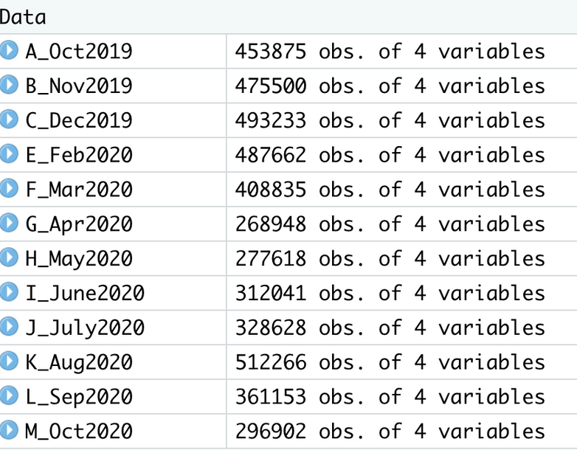
Understanding the Data
Dates Events
October 2019
November 2019
December 2019
Other
February 2020
All-Star Weekend
August 2020
Septemeber 2020
Playoffs
October 2020
Championship
Source: Aschburner, S. (2020)
Notes:
The collection of data provided contained 12 datasets, with 4 columns and an average of 389,000 rows of tweets.
After importing the data, I then researched the NBA's 2020 calendar. The first fan-favorite event that I noticed was the All-star games that occur annually in February.
Due to COVID-19, there was a pause in the NBA games, thus creating a new schedule after March of 2020 and alternative game locations with limited fan access. The playoff games were then shifted to begin August 17th, 2020 followed by the Championship games which began September 30, 2020.

Slide 4
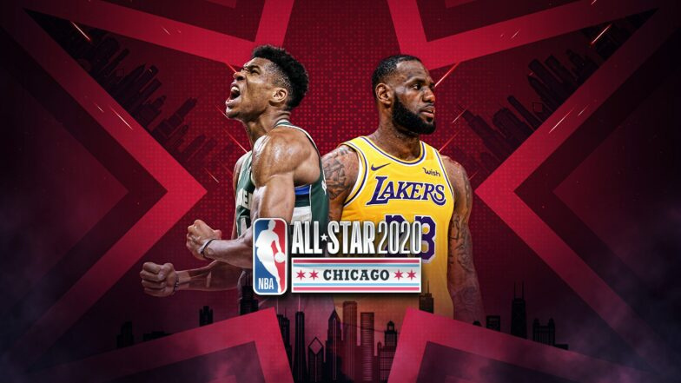
Data Selection
All-Star Weekend
February 2020
Championship
October 2020
Notes:
Based on the research done, I decided to evaluate further on the west and east teams from All-star Weekend in February 2020, and the Miami Heat and LA Lakers within the championship data in October 2020.
Due to the size of both datasets, I will further analyze 0.05% of the data above.

Slide 5
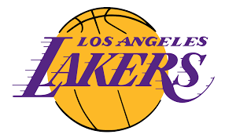
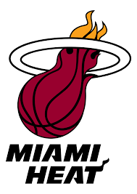
Change of Frequency
Lebron James
1.6% 3.2%
Anthony Davis
0.1% 0.8%
Jimmy Butler
0.4% 1.1%
Tyler Herro
0.4% 0.4%
All-Star Team
NBA Team
VS
WEST
Team Lebron
February 2020
October 2020
VS
WEST
Team Lebron
February 2020
October 2020
VS
EAST
Team Giannis
February 2020
October 2020
VS
DID NOT PLAY
February 2020
October 2020
Notes:
Before cleaning the data any further, I wanted to know what was the frequency of particular players who played for the heats and lakers in the championship vs when they played during Allstar weekend for either the west or east team.
Players like Lebron James, Anthony Davis, and Jimmy Butter. The percentages show growth, meaning that players who participate in the All-star games and the Championship finals are likely to be tweeted about, thus creating engagement.

Slide 6
Data Cleaning
Sub-setting (Filtering)
Stopwords
All-Star Team:
Miami Heat
Boston Celtics
Championship Teams:
Miami Heat
LA Lakers
Enabling Stop Words
Examples:
"nba", "coach", "game","win","fan","playoffs","rookie", "quarter","tickets","nike","league","team","lebron","heat", "bam", "playoffs", "points", "games", "finals", "season", "team", "lost", "home", "arena","championship", "won", "win", "tonight", "play","evidence", "nbatwitter", "dunk", "announcement",
Corpus
TrytoLower, Bigram Token
Removing Punctuations
Enabling Lowercase
Removing Numbers
Enabling Correlation
Removing White Space
Term Document
Notes:
After performing another frequency table on the sampled data, I examined the most reoccurring teams.
Based on the results from the Feb. 2020 and Oct. 2020 datasets I filtered the top 2 teams from each, which were the LA Lakers, Miami Heat, & Boston Celtics.
After subsetting the top teams. I applied various functions to clean the data to allow a more in-depth analysis.
The cleaning process involved enabling stopwords to the data such as misspellings, abbreviations, and common words that we expect in the data such as NBA, coach, game, and.
Additionally, I removed uppercase, punctuation, numbers, and whitespace from the tweets.

Slide 7
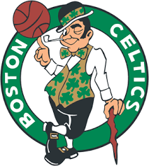
All-Star Tweet
Analysis

Slide 8
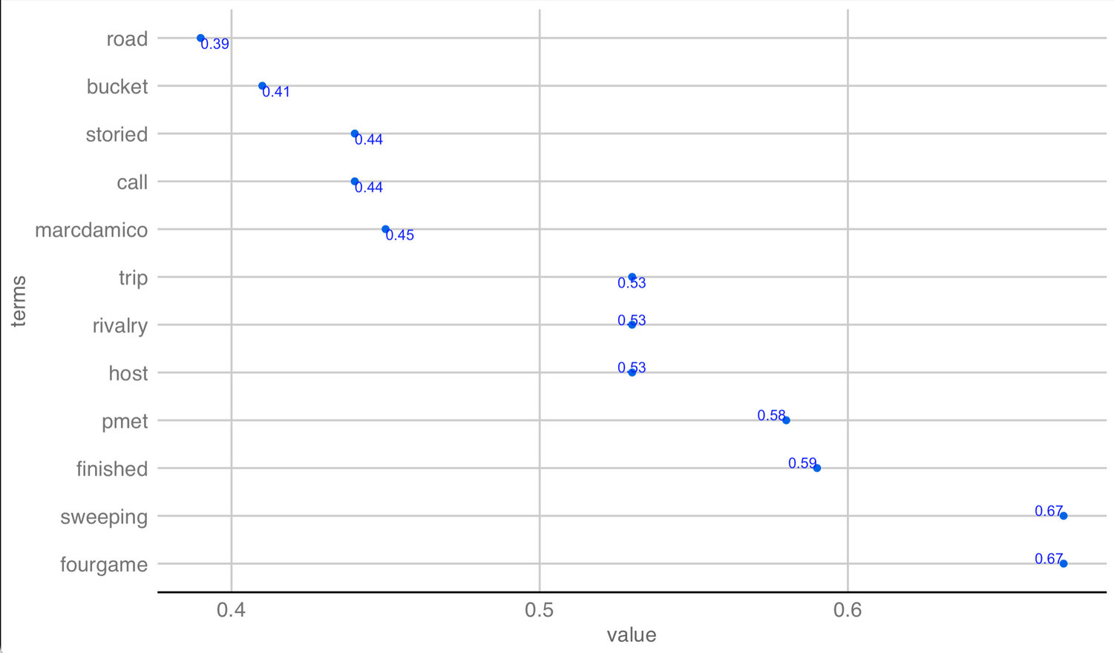
Insights
Word Association
Words associated with"west"
from the All-Star dataset
Notes:
After cleaning the data, I began to analyze certain words to see what other terms are associated and have high correlations.
Based on the word association, I created a graph to highlight the correlation points and the association.
The graph on the right reflects the results from the word 'west'. As we can see the highest correlation based on fan tweets are fourgame and sweeping.
Research shows that the all-star weekend events feature multiple games such as U.S vs World, the Celebrity Game, and mini-events leading up to the west vs east game fan-favorite player games.
Although the game concluded with a tight score with the west winning, in the 2nd quarter team east won 51 - 30 for a sweeping lead, therefore creating the discussion of the all-star game in tweets and the correlation with the word west.

Slide 9
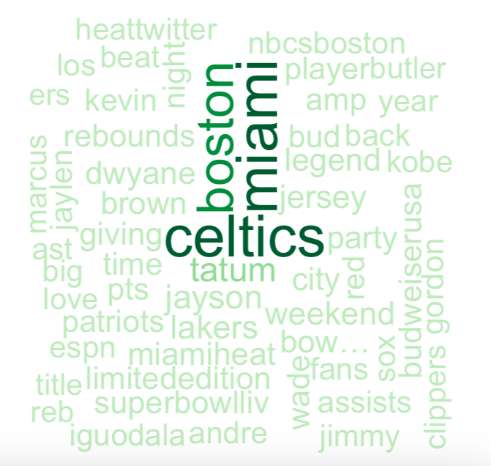
Insights
Word Cloud
Notes:
Based on the word cloud analysis
We see a variety of players, both past and present from both subsetted teams as mentioned.
The Celtics players include Marcus, Jaylen, and Jayson. While the other players such as Dwyane, Kevin, Jimmy, and Andre represent the Heat.
We can also notice popular hashtags such as #heattwitter, #playbuttler.

Slide 10
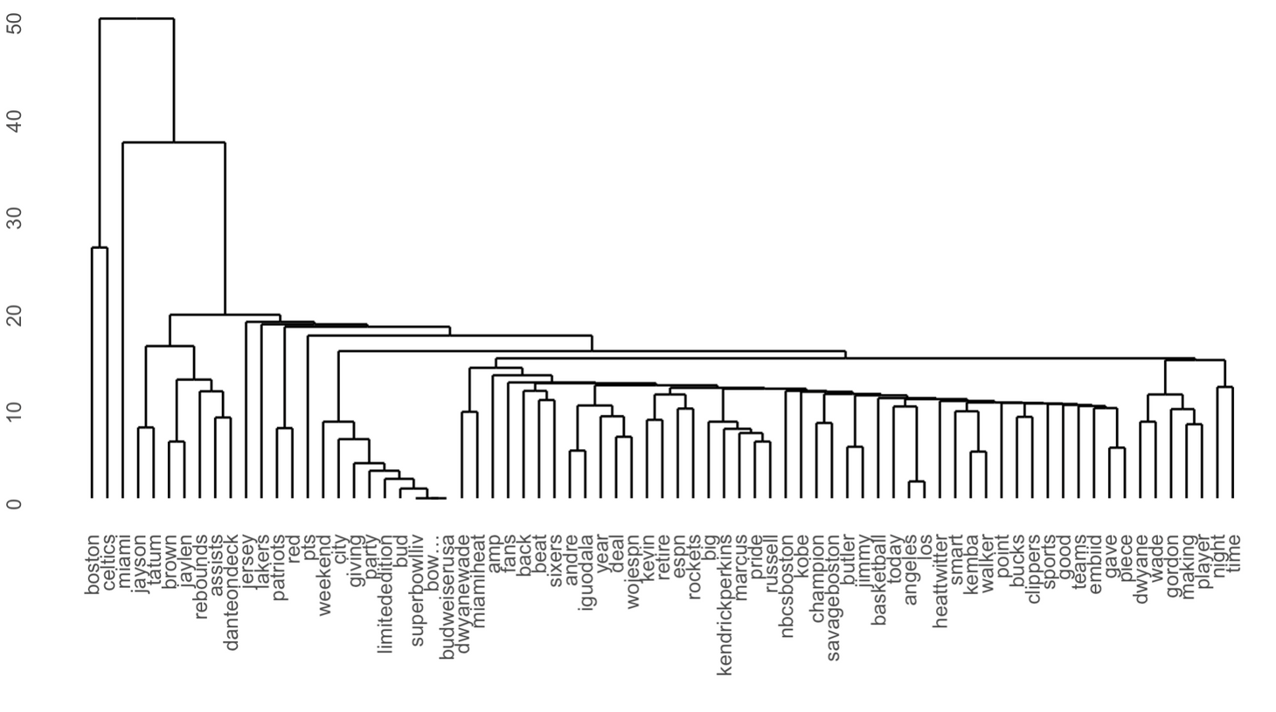
Insights
Denogram
Notes:
To determine more details about the previous word cloud a clustering graph can help us determine the frequency.
Out of the 3 players mentioned, Jayson Tatum's name stands out from fan tweets.

Slide 11
Championship Tweet Analysis

Slide 12
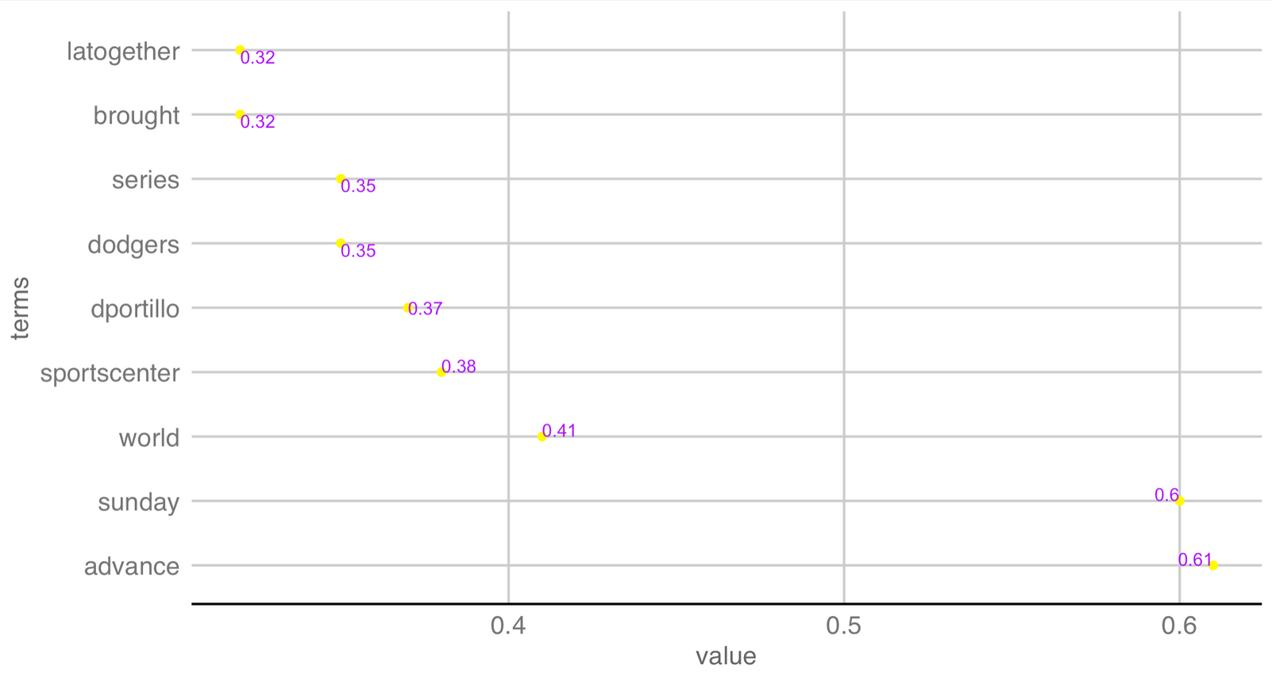
Insights
Word Association Graph
Words associated with"title"
from the Championship dataset
Notes:
Despite fans having limited access, to the arena, they communicated through Twitter to share their voice as the lakers and heat faced off in the final series.
On October 11th, 2020 the LA Lakers defeated the Miami Heats and were named the 2020 Champions.
Notice that the word 'title' is associated with several sporting events, hashtags, and discussions. The dodgers, sportscenter, and latogether were also correlated to the city of LA winning both the NBA and MLB 2020 titles. The hashtag latogether was used to celebrate both sporting teams.
One of the highest correlations is 'Sunday' which is the day the la lakers won their 2020 title.

Slide 13
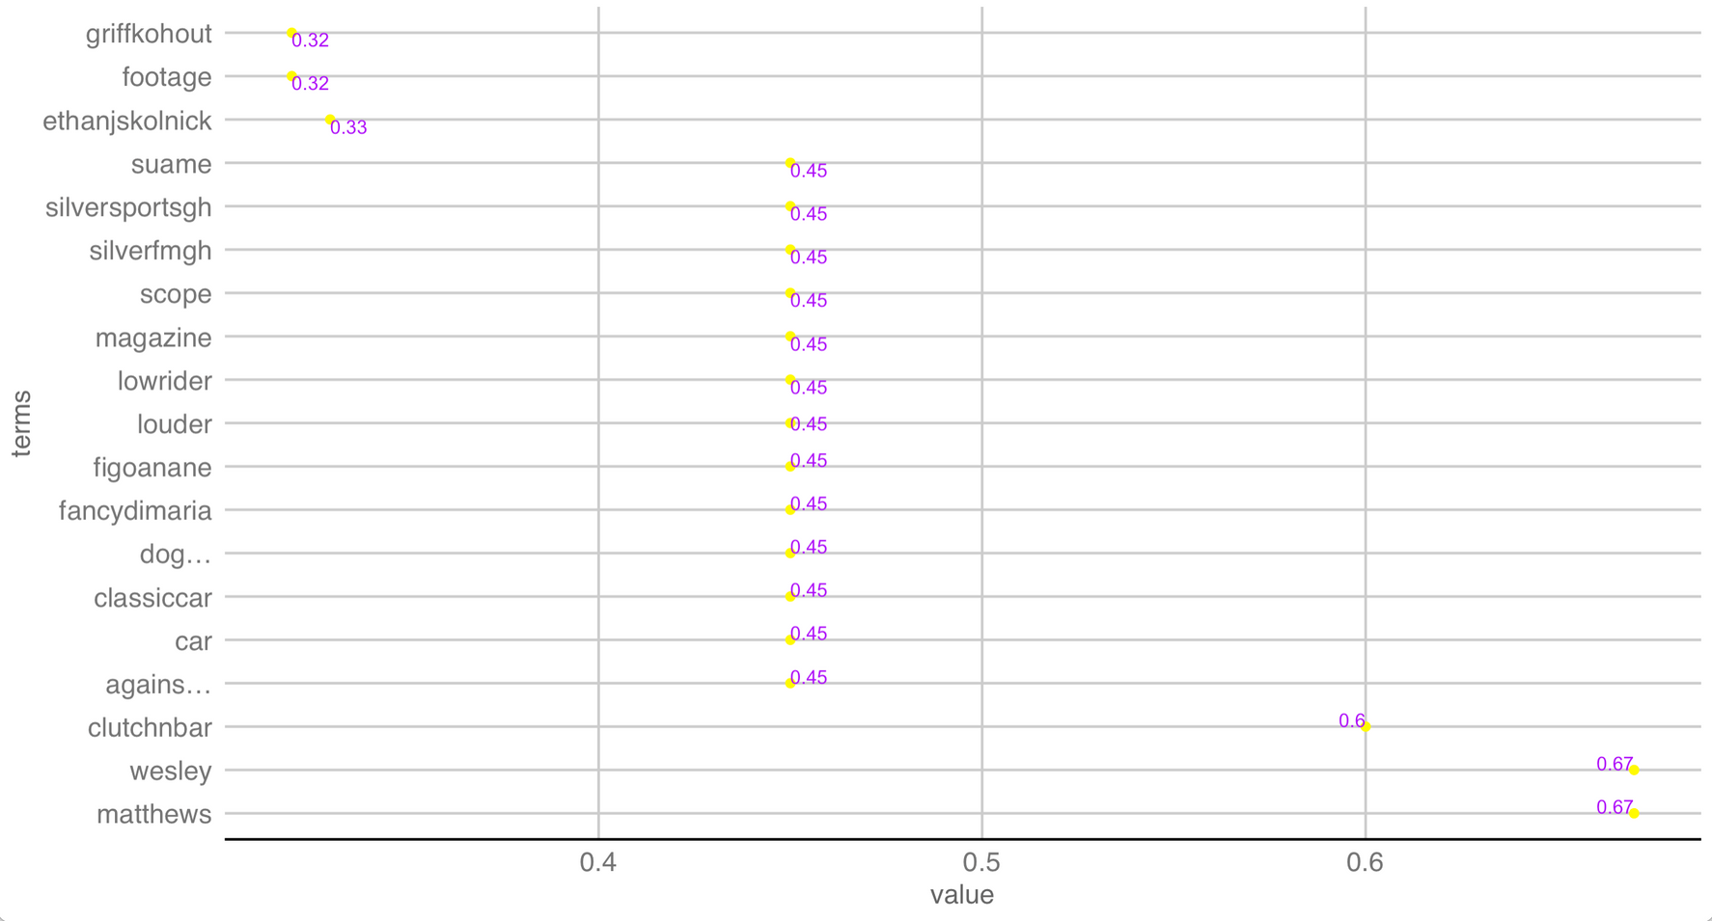
Insights
Word Association Graph
Words associated with"show"
from the Championship dataset
Notes:
From the same dataset, I also analyzed the word, "show" which had the highest correlation of a past player "Mathew Welsey".

Slide 14
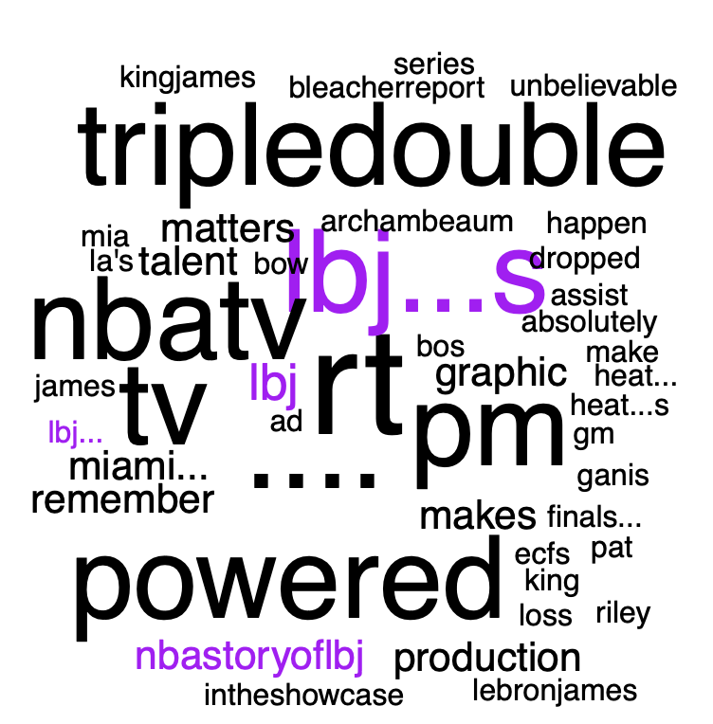
Insights
Word Cloud
"lbj" initials of LA Laker Lebron James
Notes:
As Lebron James was titled the MVP of the NBA 2020 Finals, I wanted to further analyze the fan tweets surrounding him.
The term LBJ is the initials of the player, and we see many tweets highlight his career points of triple-doubles and his athletic ability.

Slide 15
Most Tweeted Topics
All-Star Team
Miami Heat:
Heat Twitter
Jimmy Butler
Boston Celtics:
Jayson Tatum
Summary
Championship Teams
Miami Heat:
Loss
LA Lakers:
2020 Winners
Sports in LA
Notes:
To summarize the topics shared from the analysis above, we notice that the theme of the Miami heat include Heat Twitter and Jimmy Butler. While the Celetics theme surrounds Jayson Tatum.
In comparison to the championship teams the Miami heat team has more tweets related to their loss, while the Lakers celebrate their 2020 title.

Slide 16
Recommendations
Championship Cities:
Create products and experiences that highlight a city featuring multiple sports teams
All-Star:
Include custom designs of the selected city through all-star jerseys before game four (main event).
Notes:
Based upon the analysis, I believe the following recommendations can be implemented into our marketing and product sales for next year.
1.
Emphasizing and seizing the movement of fans when multiple sports team from a city wins.
2. Promoting custom designs of all-star jerseys with the selected city being showcased for fans to purchase before game four.

Slide 17
Fan Engagement
Thank You

Slide 18
References
Aschburner, S. (2020). "Coronavirus pandemic causes NBA to suspend season after player tests positive". Retrieved from https://www.nba.com/news/coronavirus-pandemic-causes-nba-suspend-season.

